Slide 1
PHYSICS
THE BASICS
HTTPS://YOUTU.BE/STCQTLJXLOK

Slide 2
Why do we need to learn about the physics of ultrasound?
Diagnostic ultrasound is widely used to make clinical determinations regarding patient care. It is a powerful non-invasive imaging tool.
Sonographers must understand how ultrasound waves create images, so they can better manipulate machine settings to optimize, acquire, and interpret quality diagnostic images.

Slide 3


SONOGRAPHY PRINCIPLES AND INSTRUMENTATION – ARDMS SPI EXAM
110 questions
2 hours (120 minutes) long
1.09 minutes per question
This is how time for Quizzes/Tests are calculated

Slide 4
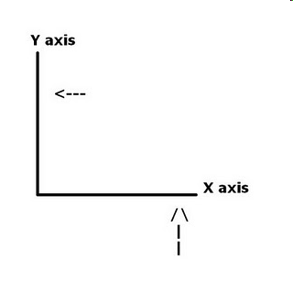
GRAPHS
In ultrasound, information is often displayed in the form of a graph.
The most used graphs have perpendicular lines on which data is displayed.
An x-axis or horizontal line
A y-axis or vertical line

Slide 5
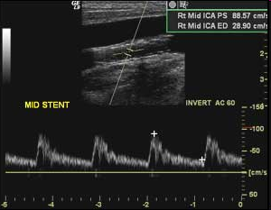
APPLYING GRAPHS TO ULTRASOUND
This is a spectral Doppler tracing that is used to measure blood velocity.
In this case:
The x axis is time
The Y axis represents velocity of blood

Slide 6
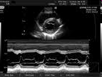
RELEVANCE
In m-mode ultrasound the x-axis represents time and the y axis represents the depth of reflectors (distance from the transducer)
In echocardiography M-mode is used to assess motion of the heart and valves in real time.

Slide 7
RELATIONSHIPS
In ultrasound physics, we often describe the relationships between two different parameters or variables.
Two items can be
Related (proportional) or Unrelated

Slide 8

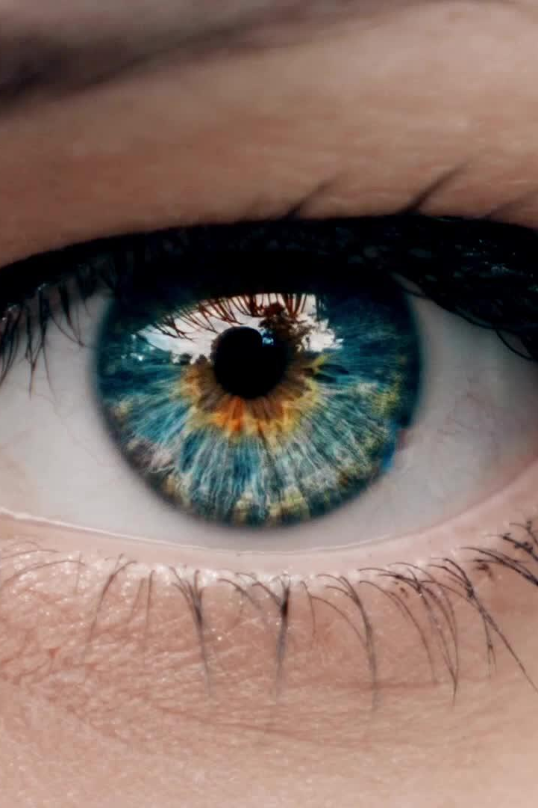
NO RELATIONSHIP OR UNRELATED
Two items that are not associated or have no bearing upon each other.
Examples:
Hair color is unrelated to intelligence
Your income is unrelated to your eye color.

Slide 9
TYPES OF RELATIONSHIPS
When variables are related, they can be:
Directly related (directly proportional)
Inversely related (inversely proportional)
Reciprocally related

Slide 10
DIRECT RELATIONSHIPS
Two variables are related in a way that when one changes the other changes in the same way.
When one decreases the other decreases.
When one increases the other increases.
Examples:
Clothing size is directly proportional to the age of a child (increase in age = increase in size)
The age of a tree and its size are directly related

Slide 11
INDIRECT RELATIONSHIPS
Two variables are related to each other such that:
When one variable decreases the other increases.
When one variable increases the other decreases.
Examples:
Golf scores are inversely related to skills
(great skill = lower score)
A car’s miles per gallon is indirectly proportional to its size
(large, heavy cars use more gas = low miles per gallon)
Notes:
When possible, it helps to use the same pairings of adjectives (lesser/greater small/large long/short)

Slide 12
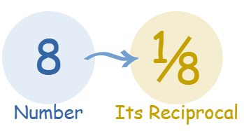
RECIPROCAL RELATIONSHIPS
A type of inverse relationship
When one increases the other proportionally decreases
When two numbers are multiplied together the result is one. (1)
Examples of reciprocals:
2 and ½ are reciprocals
1/100,000th and 100,000 are reciprocals
the reciprocal of 10 is 1/10

Slide 13
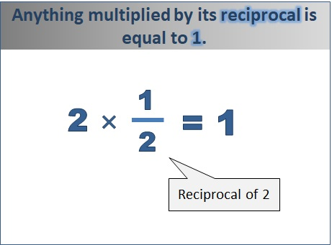
Reciprocal relationships: if one factor changes the other changes inversely.
So…
If factor A is doubled, factor B will be halved
If factor A is tripled, factor B will be 1/3 what it was
If factor B is quartered, factor A will quadruple
Notes:
Period and frequency

Slide 14
CHECK IN:
Factor A and B are reciprocals. Factor A increases 8 times. What happens to factor B?
Factors A and B are reciprocals. Factor B is doubled. What will happen to factor A?

Slide 15

IMPORTANCE OF UNITS
All numerical values must have units
Units give the numerical value meaning.
Example:
Someone states that they are 6 tall…??
A unit must be given to interpret what 6 tall means

Slide 16
IMPORTANCE OF UNITS
Unless a number is a percentage or it is directly stated that it is a “unitless” number, units MUST be given to define the number and eliminate ambiguity.
Any unit that is technically correct can be used even if it is unconventional!
You can measure a mile in inches, you wouldn’t usually, but it would still be technically correct. 1 mile= 63,360 inches
You can measure your height in miles and it would still be technically correct!

Slide 17
UNITS
All numerical values must have a unit associated with them. Without these units the numbers are ambiguous
Units denote
length/distance/circumference:
inches, feet, centimeters, meters
time: minutes, seconds, milliseconds
volume: cm³ ft³, yds³
indexed volume: ml/m²
area: cm², m², ft²

Slide 18
POWERS OF TEN
Scientific Notation
Very large or very small numbers are often expressed in scientific notation.
This is a shorthand way to express these long numbers.
Example:
0.000000124 =1.24 x 10⁻⁷
1,000,000 = 1.0 x 10⁶
Shift the decimal point so the number is between one and ten, then count the zeros!
Scientific notation translates easily to the metric system.

Slide 19
USING THE METRIC SYSTEM
The metric system is used for measuring almost everything in the world based on 3 basic units:
length = meter
mass = kilogram
second = time
For ultrasound, and specifically for the physics registry, knowing how to convert numbers within the metric system is imperative.

Slide 20
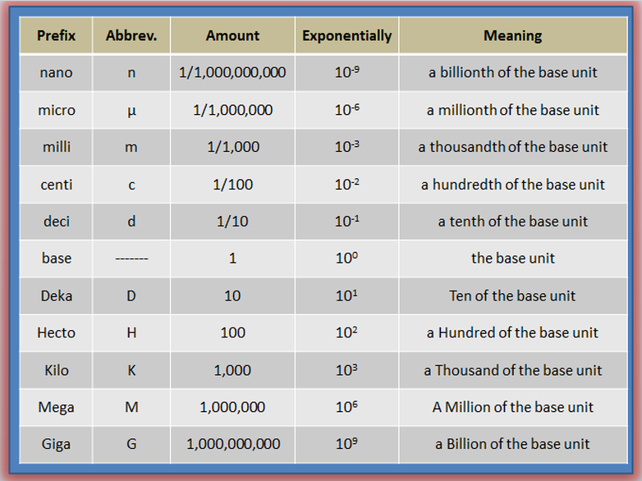
USING THE METRIC SYSTEM
Notes:
Know the pairs - look for capital vs. lowercase

Slide 21
CONVERTING WITH METRICS (THE EASY WAY)
Create a number line.
M K H D d c m μ
6_5 _4 _ 3_ 2_ 1_ 0 _-1 _-2 _-3 _ -4_-5_ -6
Figure out how many spaces are between the prefix that you have and the prefix that you need.
Notes:
I know this number-line is not the official math number-line. It is to help you with the conversion.

Slide 22
CONVERTING WITH METRICS
8 m = ___ mm
m = 10⁰
mm= 10⁻³
how many spaces are between meters (10⁰) and mm (10⁻³)
3 spaces
our number is going to be moving towards the smaller prefixes. So we move the decimal to the right.
🡪
8.0.0.0.
8000
8 m = 8000 mm

Slide 23
CONVERTING WITH METRICS
5000 mHz = ___ kHz
mHz = 10⁻³
kHz = 10³
6 spaces between the mHz and kHz
We are going to a larger prefix so we move to the left!
5000.
🡨
0.0.0.5.0.0.0.
0.005 kHz is the same as 5000 mHz

Slide 24
CONVERTING WITH METRICS
0.003 km = ___ cm
km= 10³
cm= 10⁻²
5 spaces between km and cm
we are going to a smaller prefix so we move to the right
🡪
move the decimal point 5 spaces to the right
0.0.0.3.0.0.
300 cm
0.003 km = 300 cm

Slide 25
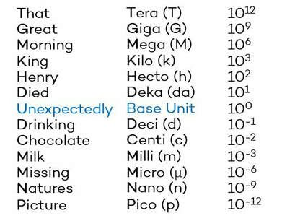
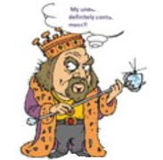
FIND A PNEUMONIC THAT HELPS YOU REMEMBER

Slide 26
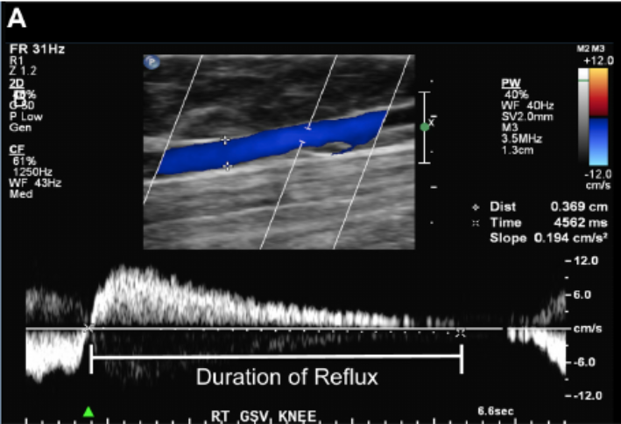
REAL WORLD APPLICATION
You’ve completed a Bilateral Lower Extremity Venous Duplex with Reflux with the following measurements:
SFJ: 4.2 cm with 1005 ms Reflux
GSV Prox: 4.6 cm with 605 ms Reflux
GSV Mid: 3.8 cm with 402 ms of Reflux
GSV Distal: 2.2 cm with 300 ms of Reflux
SSV: 2.8 cm with 209 ms of Reflux
Your reporting template reports the length measurements in mm and time measurements in secs. Please convert:
SFJ: _______ mm with _______ secs Reflux
GSV Prox: _______ mm with _______secs Reflux
GSV Mid: ______ mm with _______secs of Reflux
GSV Distal: _______ mm with _______secs of Reflux
SSV: _______ mm with _______secs of Reflux

Slide 27
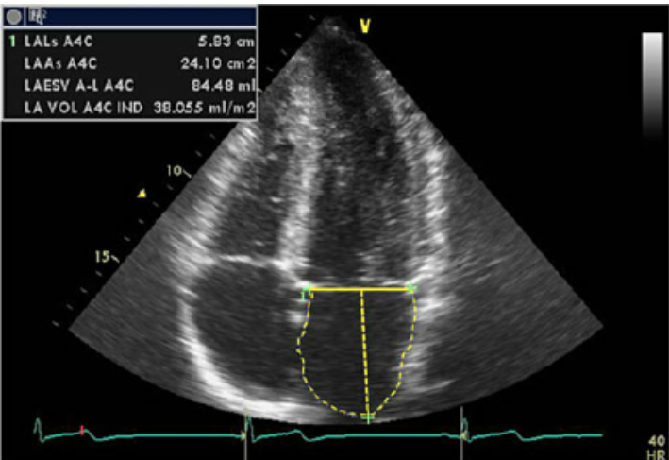
REAL WORLD APPLICATION
You’ve completed a transthoracic echocardiogram and acquired this
tracing of the left atrium in the apical 4 chamber view:
LA length:
LA area:
LA volume:
LA volume/BSA:

